Slide 1
AAL Interface (AALI): definition & implementation
Lopamudra Kundu (Lopa) and Elena Agostini
02/03/2021

Slide 2
agenda
Scope of the AAL Interface (AALI)
Definition & Implementation
AALI implementation options
Gap analysis between DPDK BBDEV API and Inline Acceleration API
Conclusion

Slide 3
Scope of AAL Interface (AALI)
Definition and Implementation
AALI Definition^{[1]}
“The AAL specification shall define the AALI – the interface between the application and hardware accelerator in the O-Cloud instance. This includes the APIs and information models used by the application to interface with the AAL implementation.”
AALI Implementation^{[1]}
“The AALI implementation itself shall not be defined by the AAL specification and is up to individual vendors to realize and can be implementation specific.”
O-RAN Cloudified Network Function
Application
AALI
SW Libraries & Drivers
HW accelerator
Proposal 1:
O-RAN shall define AALI API in terms of Requirement, AAL profiles, Operations and Information/data model.
AALI API definition should not be guided by a specific AALI implementation.
AAL implementation
(vendor specific)
O-Cloud Node
Fig. 1 AAL Interface
^{[1]} O-RAN WG6 AAL GAnP Spec.v01.00

Slide 4
AALI API implementation
Why not DPDK only?
AALI reference implementation should be a design choice
DPDK can be one of the options but should not be mandated to be the only one.
Technical challenges:
Various <processor+ accelerator + profile> combinations possible for AAL implementation.
One programming framework with specific features (e.g., DPDK’s memory management) may not be optimum for all.
Logistic challenges:
API upstreaming & approval latency + Sync. between O-RAN spec. publication & DPDK release cadence.
Not all vendors contributing to O-RAN AAL may be active members of DPDK.
Proposal 2:
AALI API definition should not dictate a specific implementation (e.g., DPDK) of AALI.

Slide 5
AALI API beyond fec (1/6)
BBDEV API and inline API: Gap analysis
BBDEV API: General features
Developed for lookaside acceleration (FEC).
Provides programming framework for “FPGA and/or fixed function accelerators”.
Assumes DPDK based memory management – mempool & mbuf.
Restriction:
Mbuf supports fixed size area for packet data payload.
Potential overallocation of memory, when packet size varies dynamically.
mbuf0
mbuf1
mbuf2
metadata
payload
metadata
payload
metadata
payload
…
Fig. 2 mbufs with fixed size within DPDK mempool

Slide 6
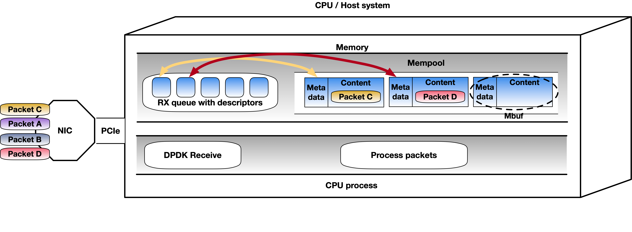
AALI API beyond fec (2/6)
BBDEV API and inline API: Gap analysis
BBDEV API: Memory management (1/2)
DPDK based memory management – mempool & mbuf (contd.)
Issue 1, RX side:
Mbufs used to receive network packets are unpredictable in a multi-threaded environment.
Application does not know in advance where packets will be received in the memory.
Requires additional steps for packet reordering.
Fig. 3 Out-of-order packet reception in DPDK mempool

Slide 7
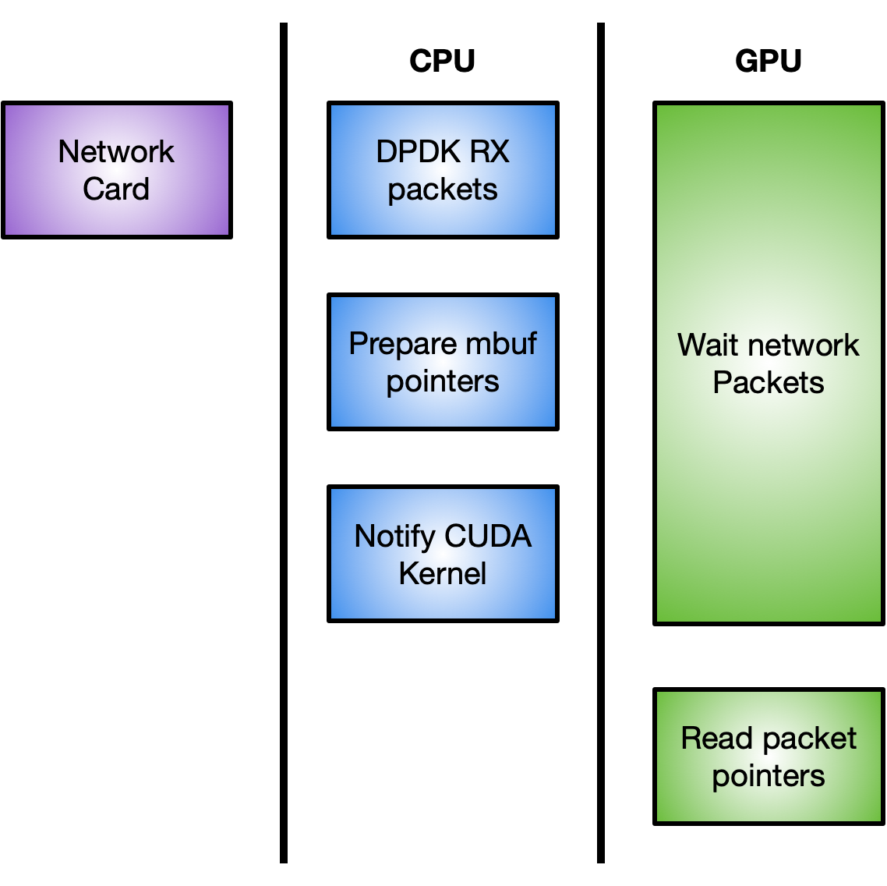
AALI API beyond fec (3/6)
BBDEV API and inline API: Gap analysis
BBDEV API: Memory management (2/2)
DPDK based memory management – mempool & mbuf (contd.)
Issue 2:
DPDK RX/TX functions require CPU into the critical path.
Can not use direct GPU <> NIC communication techniques (e.g., GPUDirect Async)
Fig. 4 CPU involvement in DPDK Rx function call
Proposal 3:
Memory management should be out of scope of AALI definition and left up to AALI implementation.

Slide 8
AALI API beyond fec (4/6)
BBDEV API and inline API: Gap analysis
BBDEV API: Queue mapping
BBDEV API is centered around the notion of “Queue” for accelerator offload.
One enqueue call can offload work associated with a single “Queue ID”.
An AAL queue supports only one type of AAL profile.
Inefficient for inline acceleration, where profiles are defined on a “per-channel” basis.
Inline API invokes enqueue function “per-slot”, with workload combining multiple “per-channel” profiles.
BBDEV API invokes separate enqueue functions for DL and UL workloads → inefficient for inline profile while accelerating workload for “S” slot.
Application
Thread #0
Thread #1
QueueID0
QueueID1
AAL DevID 1
Library|Driver
HW accelerator
Fig. 5 AAL Device with multiple queues as shown in AAL GAnP Spec.
Proposal 4:
AALI API shall provide flexibility for multi-profile workload launch in a single enqueue call.

Slide 9
AALI API beyond fec (5/6)
BBDEV API and inline API: Gap analysis
BBDEV API: Device mapping
An AAL device maps to a single HW accelerator.
Application control to which device the workload will be launched to.
Use case 1: when multiple accelerator devices are available supporting the same acceleration profile, application should not dictate workload distribution between the devices.
Example: using high speed GPU interconnect NVLINK, large workload execution can be extended over multiple GPUs (without involving CPU in between).
Use case 2: chaining of multiple profiles, supported by multiple accelerator devices.
Example: appending “rest of the PHY” acceleration on device 2 with existing FEC acceleration on device 1. Device 1 and 2 should be able to communicate directly.
Application
Api(devID1, queueID, …)
Api(devID2, queueID, …)
AAL Device 1
AAL Device 2
Library|Driver
Library|Driver
HW accelerator
HW accelerator
Proposal 5:
AALI API shall provide flexibility for implementation-specific scheduling/distribution of workload across multiple HW accelerator devices.
Fig. 6 AAL Device mapping with multiple devices as shown in AAL GAnP Spec.

Slide 10
AALI API beyond fec (6/6)
BBDEV API and inline API: Gap analysis
BBDEV API: Enqueue/Dequeue
Mapping of Queue centric enqueue/dequeue function to “multi-cell, multi-UE, multi-channel” workload is not straightforward.
“Queue ID” cannot be directly mapped to “Cell ID” and/or “UE ID” and/or “PHY channel type”.
Why? : A single enqueue invocation can not combine workload from “multiple queues”.
Alternate solution: Instead of a single Queue ID, use an array of Task IDs per enqueue call, to track progress of individual tasks (per cell/per UE/per channel), through potentially multiple dequeue calls (one per task, priority based).
ORAN_AAL_enqueue {
Task1:
CellA << PUSCH;
CellB << PUSCH;
Task2:
CellC << PDSCH;
...
Proposal 6:
AALI shall allow triggering of combined multi-cell/multi-UE/multi-PHY channel workload with a single invocation of enqueue function, using an array of “Task IDs”, instead of a single “Queue ID”.

Slide 11
Conclusion
Summary of Proposals
O-RAN shall define AALI API in terms of Requirement, AAL profiles, Operations and Information/data model.
AALI API definition should not be guided by a specific AALI implementation.
AALI API definition should not dictate a specific implementation (e.g., DPDK) of AALI.
Memory management should be out of scope of AALI definition and left up to AALI implementation.
AALI API shall provide flexibility for multi-profile workload launch in a single enqueue call.
AALI API shall provide flexibility for implementation-specific scheduling/distribution of workload across multiple HW accelerator devices.
AALI shall allow triggering of combined multi-cell/multi-UE/multi-PHY channel workload with a single invocation of enqueue function, using an array of “Task IDs”, instead of a single “Queue ID”.

